Slide 1


Input and Outputs - Part B : Solutions
Where do I find MATLAB? Here!
Do I have to have MATLAB installed on my computer right now? No, you can use MATLAB Online!

Slide 2

Table of Contents
What we covered in Part A
Introduction
Reading and Writing Excel Spreadsheets and CSV's
Tables
Work with Input Data Interactively
Now Try for Yourself!
Reading and Writing unstructured data types
What we've covered this week
Extra Resources
MATLAB Live Script

Slide 3
What we covered in Part A
In part A of Inputs and Outputs we learnt,
Different Input and Output systems
Importing data from various structured data types

Slide 4
Introduction
In Part B we continue learning about different ways to read and write data in MATLAB , we also look at interactive apps that allow you to process data and finally, we touch on reading and writing unstructured data types.

Slide 5
Reading and Writing Excel Spreadsheets and CSV's
Tables
The ability to read in data from a file onto a workspace allows for intricate algorithms to be built. Tables are one of the most common types of data structures when reading data from a file to a programming environment. Table arrays store column-oriented or tabular data, such as columns from a text file or spreadsheet. Tables store each piece of column-oriented data in a variable which may contain different types of data. For instance, tables may contain numerical data, alphanumerical or text strings, or categorical data.
The methods discussed above (fscanf and load) whilst functional, are rather primitive, in that they require a bit of effort by the user to know something about the structure of the file and its format. MATLAB has a long list of advanced Input/Output (IO) functions that can handle a wide variety of data file formats. The most common function used to read tabulated data, whether as an Excel spreadsheet or a comma-separated value file, readmatrix and readtable.

Slide 6


Reading and Writing Excel Spreadsheets and CSV's
Reading data from files using readmatrix():
mat1 = readmatrix('matrix1.csv');
mat2 = readmatrix('matrix2.csv’);
Now Try for Yourself!
Create a .csv file that has random numbers, using the readmatrix function, read the .csv file into the MATLAB environment. Comment on the results in the space below.
%This example will vary depending on what values a student puts into their
%csv file. It is important that students use the readmatrix function.
Once the files have been read, we can do some manipulation of the data and write the result back into a data file.
mat3 = mat1 * mat2

Slide 7
Reading and Writing Excel Spreadsheets and CSV's
The writematrix() built-in function can be used to save the results of "mat3" into a .csv file.
writematrix(mat3, 'matrix3.csv’)
Alternative to using the readmatrix which outputs the contents of a file into a matrix structure, the readtable() functionality can be formatted to output an actual table. Let's first create a table on the MATLAB environment using the function table().
LastName = {'Sanchez'; 'Johnson'; 'Li'; 'Diaz'; 'Brown'};
Age = [38; 43; 38; 40; 49];
Smoker = logical([1; 0; 1; 0; 1]);
Height = [71; 69; 64; 67; 64];
Weight = [176; 163; 131; 133; 119];
BloodPressure1 = [124; 109 ; 125 ; 117 ; 122 ];
BloodPressure2 = [73; 98; 101; 70; 1000000;];
T = table(LastName,Age,Smoker,Height,Weight,BloodPressure1,BloodPressure2)
The results of the created table can be written into an excel file using the writetable() functionality.

Slide 8
Reading and Writing Excel Spreadsheets and CSV's
Note: This functionality allows you to save a file under different file extensions such as .txt or .dat.
writetable(T, 'myExampleTable.xlsx');

Slide 9
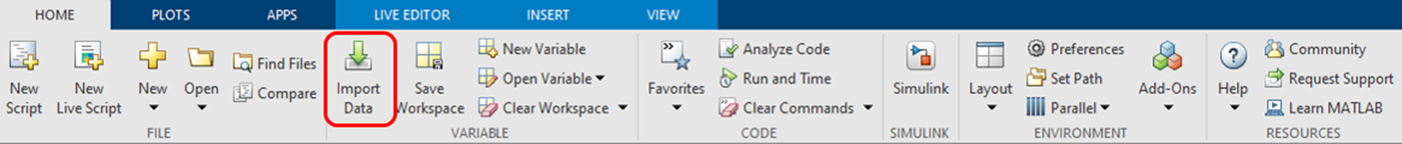
Reading and Writing Excel Spreadsheets and CSV's
Now that we have written the contents of the table to file, we can use the readtable() functionality to read the contents of the file into the MATLAB environment. Other input parameters can be specified in the readtable() function which can assist with the formatting of a table, to see more of these options read the MATLAB documentation on readtable().
clear
T = readtable('myExampleTable.xlsx')
An interactive and alternative approach to reading a file is to use the built in Graphical User Interface (GUI) for importing data into MATLAB called "Import Data". Watch a quick video on how this app can be used here. This app can be found on the toolstrip of the MATLAB app, under the "Home" tab. The icon looks as follows,

Slide 10
Reading and Writing unstructured data types
Now Try for Yourself!
Using either the built in GUI or readtable() functionality. Import any populated excel file into the MATLAB environment. Comment on the noted disadvantages/advantages of the selected approach in the space below.
%This example will vary depending on what values a student puts into their
%excel file. It is important that students use the readtable function or the GUI import data.

Slide 11
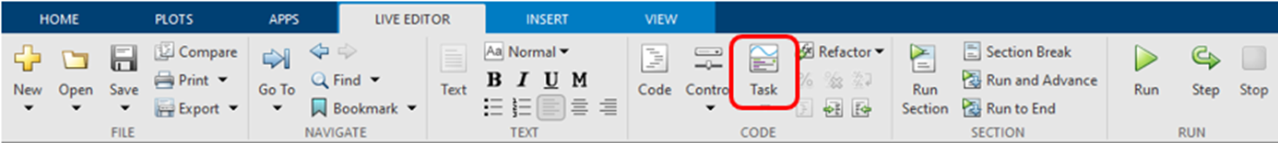
Work with Input Data Interactively
Once data has been loaded into a programming environment by the user as an input, the next step is usually to perform some manipulation of the input data as well as to plot visualisations of the data. Using MATLAB, the manipulation of this data can be done by building functions to achieve a desired output or for common data manipulation algorithms, built-in apps can be used to assist with data manipulation. We will focus on using the MATLAB's Live Editor environment built-in interactive apps to manipulate and visualise data.
On the MATLAB toolstrip, under the "Live Editor“
These interactive options allow you to perform different data manipulation function such as preprocessing and visualize data interactively on a Live Editor without the need for calling functions or writing code. In the example below, the "Create Plot" functionality is used to interactively plot a visualisation of a specified dataset that has been loaded. The different section in the functionality allow you to select the input data that has been loaded onto the workspace, chose a suitable visualisation and then a plot a display of the dataset.

Slide 12
Work with Input Data Interactively
A full set of the code used to execute this process can be seen by clicking on the triangle at the bottom of the functionality.
% Create scatter of T.Height and T.Weight
s = scatter(T.Height,T.Weight,'Marker','*','DisplayName','Weight');
% Add xlabel, ylabel, title, and legend
xlabel('Height')
ylabel('Weight')
title('Height vs. Weight’)
legend

Slide 13
Work with Input Data Interactively
Now Try for Yourself!
Using the interactive live editor, investigate the data preprocessing options and use the appropriate functionality to normalize the data in the "myExampleTable.xlsx" dataset. Use the space below to document the process and the results obtained.
%Load data
T = readtable('myExampleTable.xlsx’);
% Normalize Data
newTable2 = normalize(T,... "DataVariables",["Age","Height","Weight","BloodPressure1","BloodPressure2"]);
% Display results
clf
tiledlayout(2,1);
nexttile
plot(T.Age,"Color",[77 190 238]/255,"DisplayName","Input data")
legend
ylabel("Age")

Slide 14
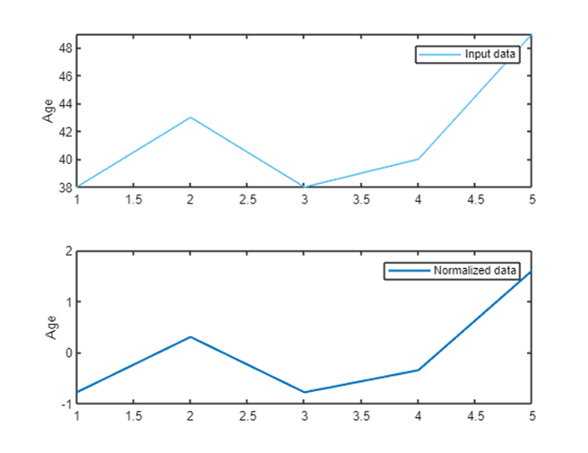
Work with Input Data Interactively
nexttile
plot(newTable2.Age,"Color",[0 114 189]/255,"LineWidth",1.5,...
"DisplayName","Normalized data")
legend
ylabel("Age")

Slide 15
Reading and Writing unstructured data types
Many common programming languages have extensive built-in functionality for reading and writing structured data types, including MATLAB. However, there are different data structures that are unstructured such as images and audio which can also be specified as an input. In this section we will particularly look at the two common functionalities for reading and writing images into the MATLAB environment: imread() and imwrite().
Use the MATLAB documentation to search how to read other unstructured data types such as audio.

Slide 16

Reading and Writing unstructured data types
MATLAB provides a comprehensive workflow for image processing, analysis and visualisation. The simplest way to begin this process is by reading in an image that is specified as an input by the user. The imread() function can be used to read in images into the MATLAB environment. This functionality supports image extensions such as .tif, .bmp and .png. More extensions can be found here.
matlabLogo = imread('MATLAB-symbol.jpg');
imshow(matlabLogo)

Slide 17

Reading and Writing unstructured data types
Hopefully by now you are familiar with the process once data has been specified as an input by a user - some form of manipulation is done to the data. In this example, we simply manipulate our input by converting our color input image into a black and white image by using the rgb2gray() functionality. More image processing functionality can be studied here.
matlabBW = rgb2gray(matlabLogo);
imshow(matlabBW)
Once our image has been manipulated to our liking, we can save the data/image using the imwrite() functionality. Note: Images can be created through plots in MATLAB and saved to file.
imwrite(matlabBW, 'matlabLogoBW.png');

Slide 18
Reading and Writing unstructured data types
Now Try for Yourself!
Using the MATLAB documentation, read in an audio, perform some kind of manipulation on the audio and write the output of the manipulated audio to file. Comment on the process in the space below.
%This example will vary depending on what audio a student uses. It is
%important that students use the audioread() and audiowrite() function.

Slide 19
What we've covered this week
This we learnt about:
Different Input and Output systems
Importing data from various structured data types
Processing data using live tasks
Importing data from unstructured data types

Slide 20
Extra resources
How to Import Excel Data into MATLAB
Data Import and Export
Preprocessing Data
Large Files and Big Data
Copyright 2022 The MathWorks, Inc. & Opti-Num Solutions (Pty) Ltd.

Slide 21
MATLAB Live Script
Click on the link below for this lecture’s MATLAB live Script
Week_4_Part_2_Inputs_and_Outputs.mlx

